Slide 1
Linear Systems, Frequency Domain & Restoration
EE551
Week 5 - Linear Systems, Frequency Domain & Restoration
Ref. Chapter 5 Gonzalez & Woods
2023

Slide 2
In this section…
Introduction to linear systems
Frequency Domain Processing
Image Restoration

Slide 3
Convolution Theorem
This is the most important of the Fourier transform theorems
It is basically saying that the transform of a convolution of 2 functions is equal to the product of the individual transforms.

Slide 4
Frequency Domain Filtering
Frequency Domain Filtering Operation
Frequency domain filtering is based on multiplying the Fourier transform of the original image by a frequency
domain filter and then taking the inverse Fourier transform. The convolution theorem shows that this is formally equivalent to convolving
the image with a spatial domain filter.
Fourier Transform
Filter Function H(u,v)
Inverse Fourier Transform
F(u,v)
H(u,v,)F(u,v)
Pre-Processing
Post-processing
f(x,y)
Input image
g(x,y)
Enhanced image

Slide 5

Linear Superposition and Convolution
Most imaging systems can be well approximated as linear systems
It is very useful to think of the imaging process as a black-box problem
In which an input (the ideal image) is acted upon by the system to produce the actual output image.

Slide 6
Linear Superposition and Convolution
An imaging system described by operator S is
linear if for any two input distributions X and Y
and any two scalars a and b –
The linear superposition integral describes the general
image formation process. In 2-D it is -
Output
Input
system

Slide 7
Linear Superposition and Convolution
Clearly it is the weighting function h which determines the basic behaviour of the imaging system. In the general case, it is a function of four variables since we must allow for the contribution of a given point in the input space to a particular point in the output space to depend on the exact location of both points.
the weighting function h tells us the specific contribution made by each infinitesimal point in the input domain to each infinitesimal point in the resulting output domain. In the context of imaging, the weighting function is referred to as the point-spread function (PSF)
Input
System
Output

Slide 8
The point-spread function
In the limit that the point becomes infinitesimal in size, we can represent the input function as a Dirac delta function -
The superposition integral then becomes -
which by definition of the sifting theorem gives -
Notes:
Sifting property – sampling by the delta function

Slide 9
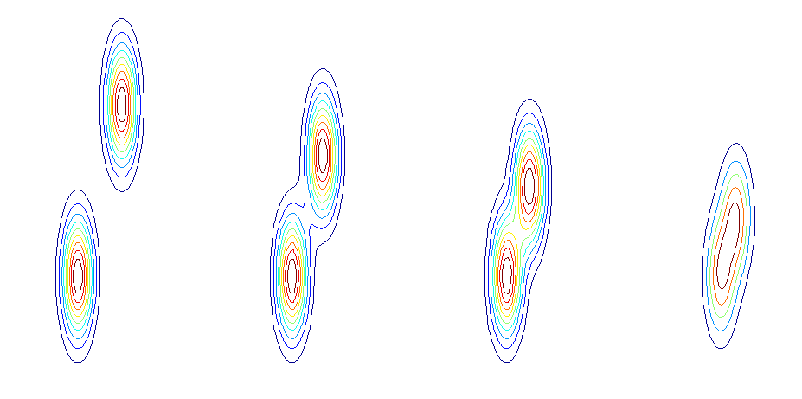
Image resolution/resolving power
The PSF determines
the image resolution
The FWHM resolution criterion: The figures show contour plots of the resulting system response as two delta-like points in the input domain approach each other.
A and B are clearly resolved, C is just resolved as the PSFs meet at the point of half-maximum intensity (the FWHM criterion). D is said to be unresolved.

Slide 10
Shift invariance (isoplanatism)
A shift invariant system is characterized by a PSF that depends only on the difference between the coordinates in the input and output domain and not on their absolute values.
Thus a 2-D shift-invariant PSF has a functional form which makes it only dependent on only 2 variables –
This has a simple physical interpretation. Consider a source point in the input domain at coordinates. If we move this source point to different locations in the input domain changing the values of the coordinates, the corresponding response (i.e. its shape/functional form) in the output domain will remain the same but will simply be correspondingly translated in the output domain.

Slide 11
Shift invariance (isoplanatism)
PSF Unaffected
Each point in the object (input) plane contributes to a number of points in the image plane.
In isoplanatic systems, this contribution depends only on a difference of coordinates between the input and image domains.
shift
Object Distribution

Slide 12
Shift invariance (isoplanatism)
If shift invariance holds, the linear superposition integral becomes a
convolution integral –
This integral is so important that it is often
simply abbreviated by an asterisk operator
Convolution is a fundamental process describing the way in which a linear
System “mixes up” the ideal input image with the PSF. The addition of a noise
term gives the so-called imaging equation

Slide 13
Shift invariance (isoplanatism) – image formation
Each image in the top row shows arbitrary points in the input domain (increasing from left to right) whilst the images below them show the response of a linear, shift-invariant (LSI) system to the corresponding input.
The final image at the bottom right consists of a weighted superposition of responses to the input points.

Slide 14
The Optical Transfer Function
The proper mathematical expression of this property by which an imaging system transfers the harmonic input components to the output is called the optical transfer function (OTF).

Slide 15


The OTF
INPUT HARMONICS
OUTPUT HARMONICS
One way of assessing image quality is by imaging
sinusoidal-like test patterns of increasing frequencies
and assessing what frequencies remain visible
in the image.
SYSTEM

Slide 16
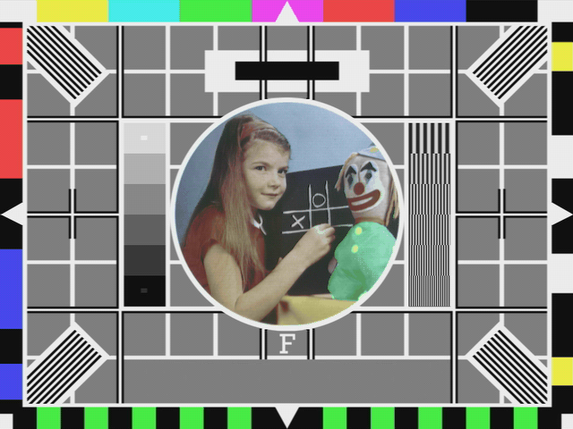
The OTF
The old BBC Test Card
This test pattern was used to assess the quality
of the transmitted picture. Note the sinusoidal patterns (to measure resolution) and the blocks of different grey scales (to measure contrast)

Slide 17
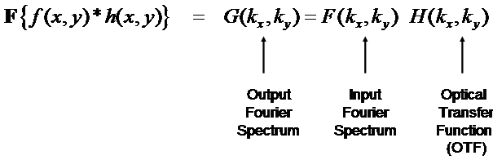
Convolution Theorem
This is the most important of the Fourier transform theorems
It is basically saying that the transform of a convolution of 2 functions is equal to the product of the individual transforms.
We can apply this to the imaging equation as a means of undoing the effect of convolution.
Note the Fourier domain
Equivalent of the PSF is called the optical transfer Function (OTF)

Slide 18
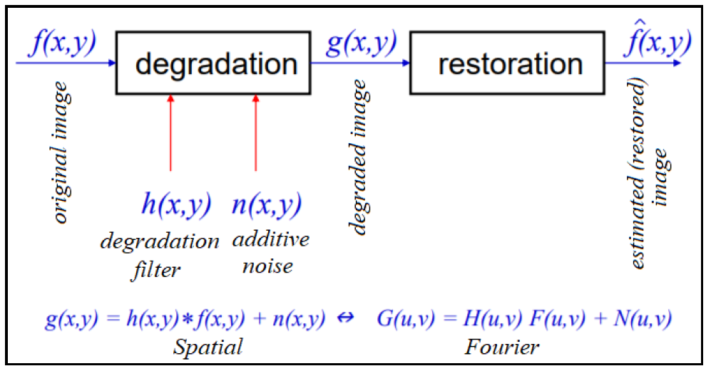
Image restoration
Key insights:

Slide 19
Deconvolution
Imaging equation is
We WANT
We have
In general, the noise is unknown although we may have
some knowledge of its statistical behaviour
Apply the convolution theorem

Slide 20
Deconvolution (Image restoration)
If there is no noise solution is easy -
We thus have
And the input is recovered by an inverse Fourier transform -
The frequency domain filter Y is called the inverse filter -

Slide 21
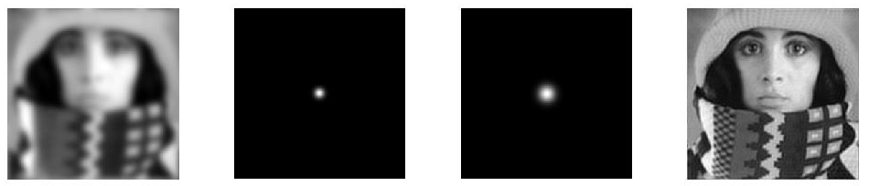
Deconvolution (Image restoration)
Restoration of a blurred but noiseless image through inverse filtering.
From left to right
i) Blurred original.
ii) gaussian point-spread function.
iii) corresponding MTF
iv) Recovered original.

Slide 22
Deconvolution (Image restoration)
If there IS noise the inverse filter leaves us with a problem -
1. The OTF of any imaging system will generally not extend to the diffraction limit. This means that any attempt to recover spatial frequency pairs which may exist in the input but at which the OTF of the system has dropped to an effective value of zero will be disastrous.
2. The Noise term may dominate the OTF at high frequencies. The result is a boost in the high frequency noise.

Slide 23
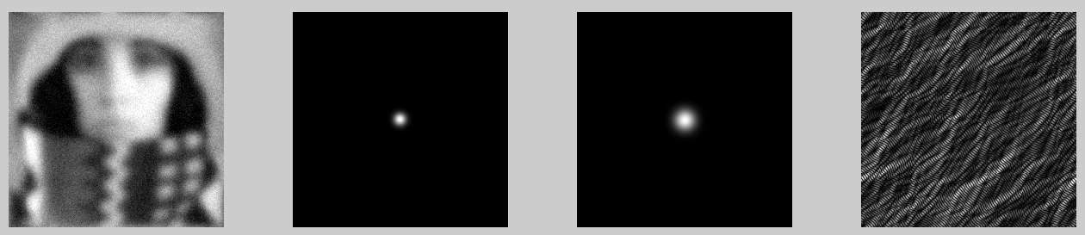
Deconvolution (Image restoration)
Restoration of a blurred and noisy image through inverse filtering. From left to right
i) Blurred original with Gaussian white noise (zero mean, 0.2% variance)
ii) gaussian point-spread function
iii) Corresponding MTF
iv) Recovered image.
Clearly the noise has a disastrous effect.

Slide 24
Inverse FFT for restoration – impact of noise
iFFT – no noise
iFFT – with Gaussian noise
iFFT cannot restore image

Slide 25
Image restoration
What would be the ideal behaviour of our filter ?
1. At those spatial frequency pairs for which the noise component N << G our filter should approach the inverse filter.
2. At those spatial frequency pairs for which the noise component N >> G our filter should approach ZERO. This ensures that we don’t attempt to restore spatial frequency pairs which are dominated by the noise component.
3. At those spatial frequency pairs for which the noise component N ~ G our filter should “damp” these frequencies, effecting an appropriate compromise between complete acceptance (inverse filter) and total suppression.

Slide 26
Wiener Filter
Examination of the Wiener filter shows that it satisfies these properties.
Note the Wiener filter requires knowledge of the input power spectrum
and of the noise power spectrum.

Slide 27
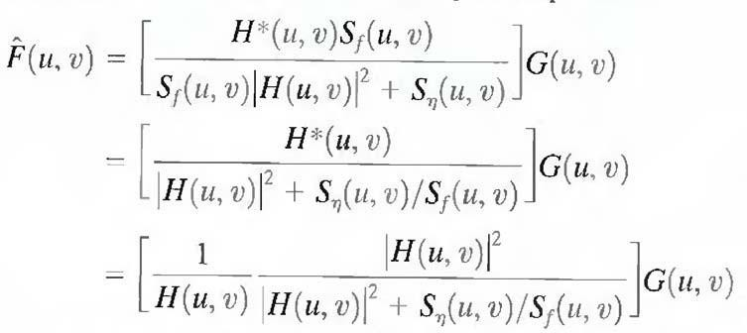
Wiener Filter
F(u,v) = Fourier Transform of undegraded image
G(u,v) = Fourier Transform of degraded image
H(u,v) = degradation transfer function
H*(u,v) = complex conjugate of H(u,v)
|H(u,v)|^2 = H*(u,v)H(u,v)
Sn(u,v) = power spectrum of noise)
Sf(u,v) = power spectrum of undegraded image

Slide 28
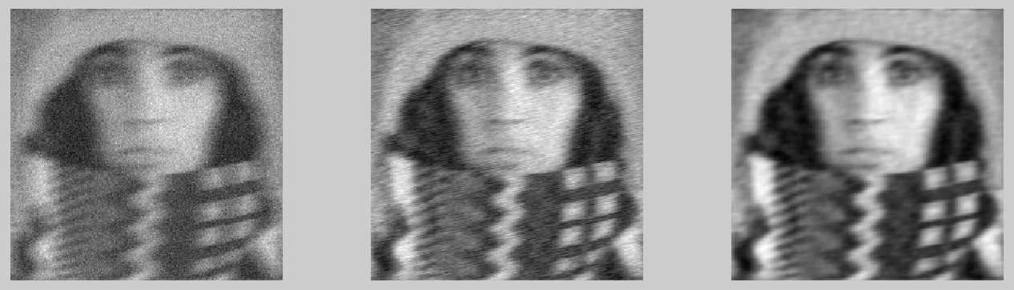
Wiener Filter
Restoration of a blurred and noisy image through Wiener filtering.
From left to right
i) Blurred original with gaussian white noise (zero mean, standard deviation ~10 % of mean signal)
ii) Wiener filtered with scalar estimate of total power in noise and signal
iii) Wiener filtered with autocorrelation of noise and signal provided.

Slide 29
Wiener filter in Python
skimage has an in-built function specifically for carrying out Wiener filtering. Essentially, it can be used in 3 different ways –
The user supplies the point-spread-function (PSF) responsible for the blurring only. In this case, it is assumed that there is no noise and the filter reduces to the inverse filter.
The user supplies the PSF responsible for the blurring and a scalar estimate of the noise-to-signal power ratio, NSR. In other words, only the total amount of power in the noise and in the input are provided and their frequency dependence is not supplied.
The user supplies the PSF responsible for the blurring and a frequency dependent estimate of the noise-to-signal power ratio, via their respective autocorrelation functions. (Recall that the autocorrelation theorem allows the calculation of the autocorrelation from the power spectrum).

Slide 30
Blind Deconvolution
In the frequency domain, the “standard”
deconvolution problem is -
We don’t know F of course. However, we often don’t
know what the system OTF H is. (e.g. many forensic
applications). We never know the noise, N. It seems an
impossible problem !

Slide 31
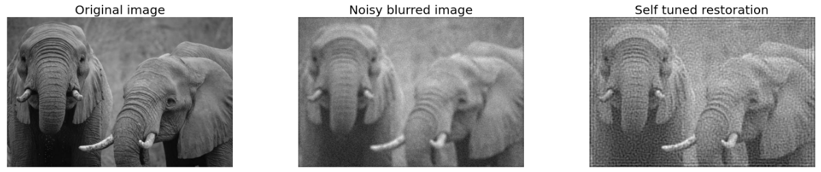
Blind Deconvolution
Remarkably, it is often possible to blind Deconvolve.
Details go beyond scope of this course but it is to do with the constraints that naturally exist on PSFs and images (positivity, finite Support)

Slide 32
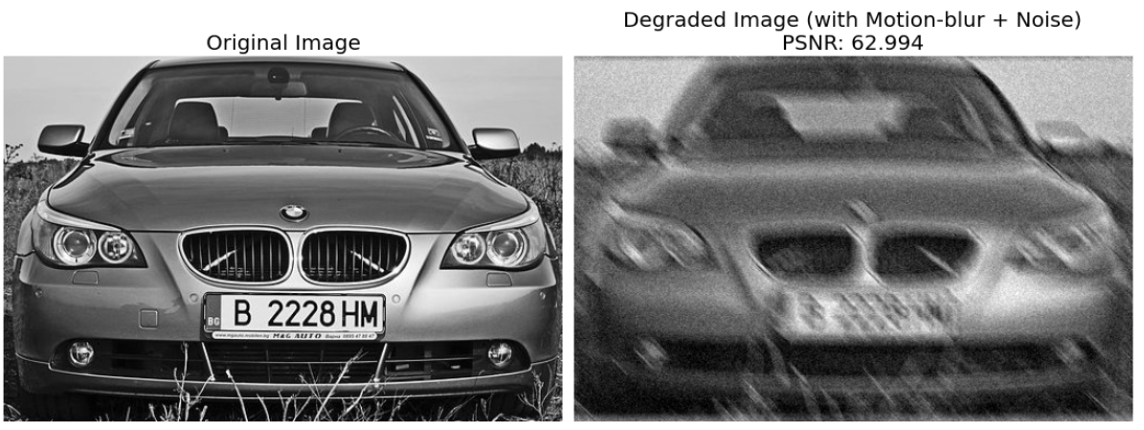
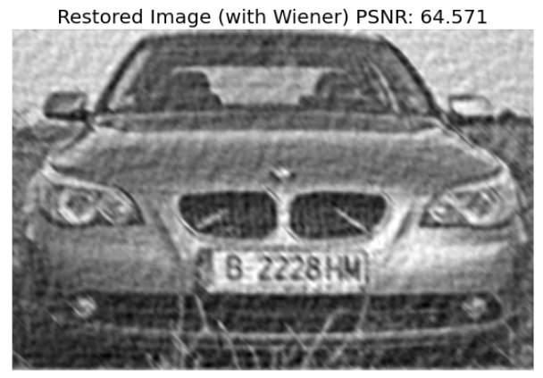
Case Study – Reading car license plate

Slide 33
Questions?

